Slide 1
Graphics in Java
Starring: NetBeans
Co-Starring: Java.awt

Slide 2
Graphics – An Introduction
In order to show you Java graphics, we will walk you through the basics of making a project using the AWT package
AWT is a group of classes that work together to create programs that the user can interact with graphically

Slide 3
Graphics
AWT creates a GUI (graphical user interface) allowing you to avoid using the console which can only display a limited range of data
We will also be basing our code on events – things that the user does to move the program along such as clicking a button or pressing a key

Slide 4
Applets
Our code will be based upon applets, which are similar to applications, but are designed to operate off of an html enabled web browser
Consequently, they are driven by a short html code sequence, rather than an SPVM
Fortunately, most of this is abstracted from the user, so the coding is very similar to that of an application

Slide 5
Lets Get Started!
Open up NetBeans™
Click New Project ->new as you usually do
Select “General” AND “Java Class Library”
Fill in the same boxes you would with an application, be sure to name the applet and select an appropriate location (folder)

Slide 6
Creating an AWT Applet
You need to create a new java file in which to build your applet.
Right-click the project “Source Package” Folder
Select “Java Classes” and Applet or JApplet
Name your Applet and associate it with the Source Packages
Finish

Slide 7
Creating an AWT Applet
You COULD use NetBeans GUI capability to generate a frame that behaves much like a VB form
With this Frame you can add objects like you did in VB
However, we are leaving out this topic for now, However, you can utilize ANY capability of NetBeans (on your own)

Slide 8
The Code
Take note of the absence of an SPVM
public class MyApplet extends java.applet.Applet
{
/** Initialization method that will be called after the applet is loaded
* into the browser.
*/
public void init() {

Slide 9
The Init() is where we put the initial behaviors we want to execute when the applet “loads”
Remember Applets execute from HTML, to hae the HTML generated, RUN the java applet
If you want to see the html code that our applet will run upon, look in the projects “Build” Folder in Windows

Slide 10
<HTML>
<HEAD>
<TITLE>Applet HTML Page</TITLE>
</HEAD>
<BODY>
<H3><HR WIDTH="100%">Applet HTML Page<HR WIDTH="100%"></H3>
<P>
<APPLET codebase="classes" code="MyApplet.class" width=350 height=200></APPLET>
</P>
<HR WIDTH="100%"><FONT SIZE=-1><I>Generated by NetBeans IDE</I></FONT>
</BODY>
</HTML>

Slide 11
At This Point, you could EXECUTE your appley simply by clicking on the HTML Document
It will invoke Internet Explorer and IE will generate your applet

Slide 12
The Java File
Find the initComponents() method
That is where the code creating objects goes
We will code the creation of objects manually, but you can use Netbeans to graphically build your GUI (again, we will discuss this at a later time, however, feel free to experiment now)

Slide 13
Hello World
Lets generate our first applet that displays the infamous “Hello World”
Create a paint method as follows:
public void paint(Graphics g)
{
g.drawString("Hello World", 50, 25);
}

Slide 14
Hello World
Make sure we import the required java classes, so include these at the top of the program:
import java.applet.Applet;
import java.awt.Graphics;
import java.awt.*;
import java.awt.event.*;
Now, run your applet by r-clicking on the java file and selecting RUN

Slide 15
Now, we will extend out applet to:
Add a button and a label
Set properties of each
Allow button events to be captured and processed
Use “interfaces” to trap KEY EVENTS

Slide 16
Use the class handout or the completed applet online to add a button and a label to your applet
Remember to run your applet by r-click on the java file and selecting RUN
Sample output …

Slide 17
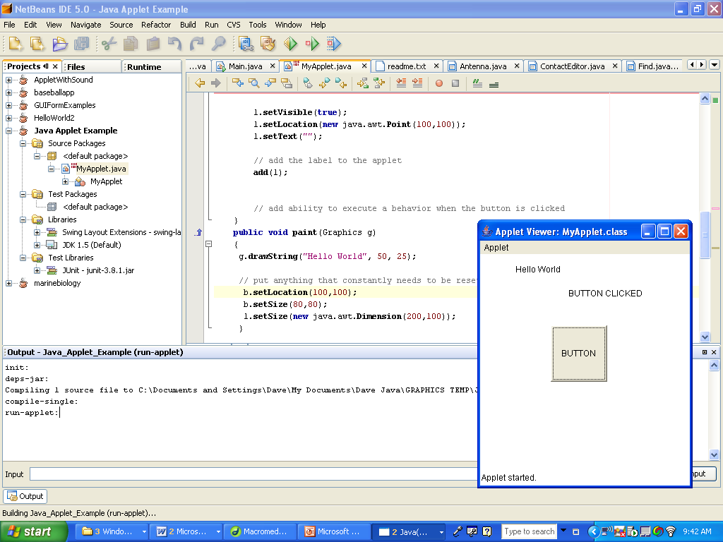
Sample output …

Slide 18
Classes
Recognize that all of the things you add to the applet are objects, and can be viewed in JavaDocs
Consequently they all have methods and attributes
Try looking up Button in JavaDocs and find its methods and attributes

Slide 19
More on Classes
Right after the class declaration and before the constructor, you should find the button declaration:
button1 = new Button()
Notice the new, indicating the creation of an object

Slide 20
Still More on Classes
Now go down to the init () method
Look at the various “set” methods called on the button
These methods set the values for the various attributes of the button object
Finally, look at the “add” call on the button, which places the button in the applet

Slide 21
Mess Around
Try changing the various properties of the button
Then create a label, a textbox, and whatever else you want
Try changing the properties of these objects, and see what you can do

Slide 22
Now For Some User Input
Graphics allow the user to control various aspects of the program
User inputs such as pressing a button or hitting a key are called ActionEvents
You can write code to make your project react to these ActionEvents and do virtually anything

Slide 23
ActionListener
If you want a graphics component to respond to some user input, such as the clicking of a button, an “ActionEventListener” must be added to the component.
This listener does what it sounds like—it “listens” for the activation of a component
The listener in turn activates an outside method that includes the actual code that is executed when a component is activated (button is clicked, etc)

Slide 24
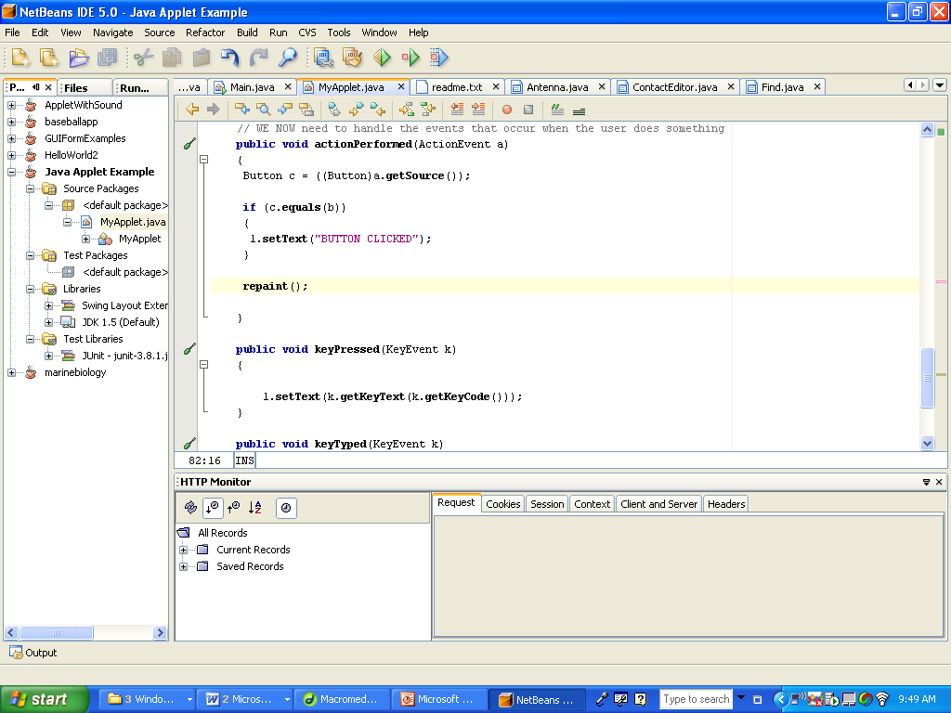
What it looks like…

Slide 25
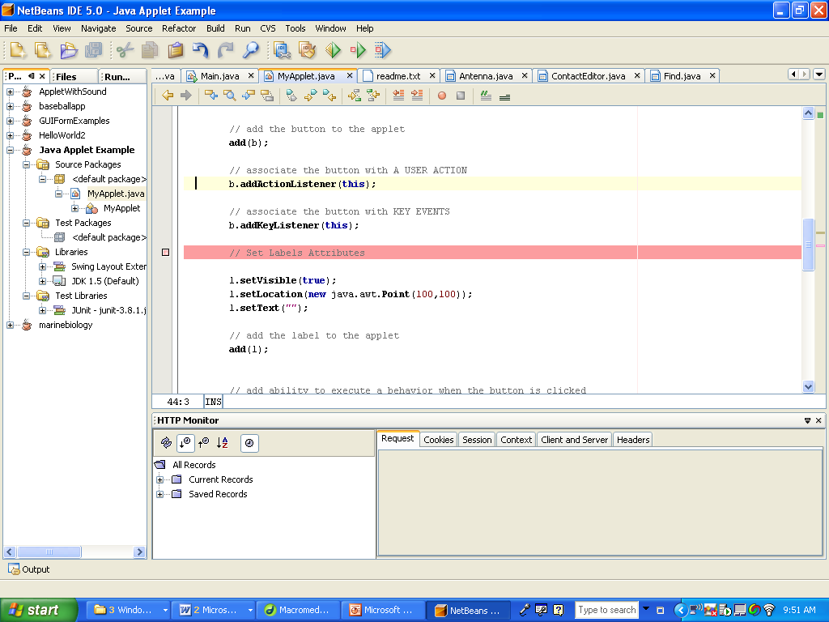
What it looks like…

Slide 26
Interpretation
In the previous slide, you can see the ActionListeners for the button. As you might notice,
On the bottom are the “ActionPerformed methods. In them goes the code describing what the buttons should do when they are clicked

Slide 27
Additional Events
Of course, you might also need to handle additional events, such as moving the mouse over a component, or clicking and dragging. Thus, there are numerous other types of events that all operate in a similar manner
Take a look at JAVADOCS to see what additional events exist in Java
For your purposes, ActionEvents are sufficient for the time being, as they are the simplest and are automatically configured for the default actions of every component.

Slide 28
Experimentation
Try fooling around with ActionListeners and “ActionPerformed” methods to get a better feel for how they operate.
As a short exercise, try making an applet with a button and a label, where the color of the label changes when you click the button.

Slide 29
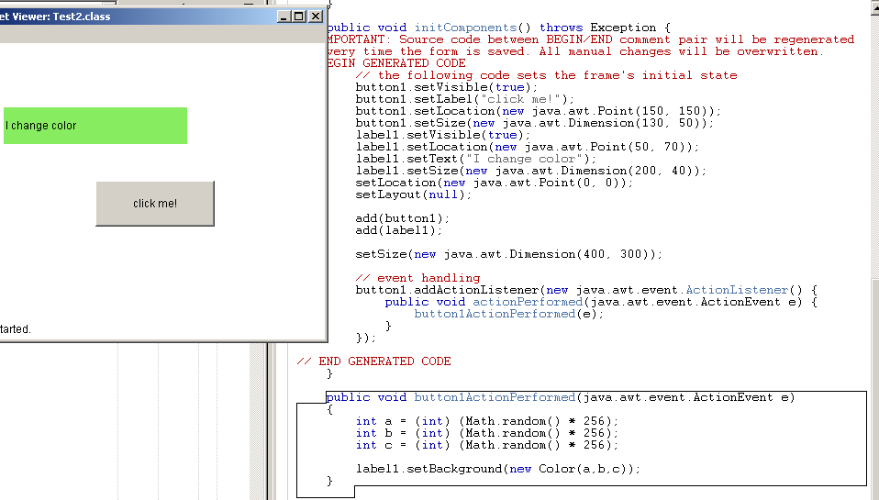
Solution

Slide 30
Control Arrays
In more complex Applets, the amount of components increases to the point where it becomes inefficient to code for the individual ones if they operate in a similar manner.
If you have ten buttons that do similar things, it might be convenient to create an array of buttons, to hold them in an organized way.

Slide 31
Tic-Tac-Toe
Your first real project is to complete a Tic-Tac-Toe program using graphics as well as a control array.
Naturally, because you would need nine buttons, one for each square in the 3x3 grid, a control array would be perfect for this project.
This would reduce some of the redundant code, as all of the ActionEvent handling would occur in the same ActionPerformed method!
So instead of nine ActionPerformed methods, we only need one.

Slide 32
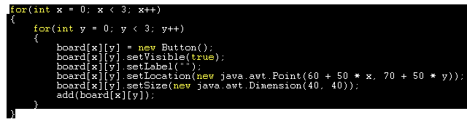
Creating the Control Array
You would use a for loop to instantiate all of the buttons
Remember—no “new,” no new object!
Take a look at the sample code.

Slide 33
Using the control array
When instantiating the control array, it is useful to set the ActionListeners in the loop, but make sure that they point to the same ActionPerformed method, such as boardActionPerformed where board is a 3x3 control array of buttons.
In the ActionPerformed, use the getSource() method from the ActionEvent class, which returns the actual button that has been clicked.

Slide 34
Using the control array
For example,
public void boardActionPerformed(ActionEvent e)
{
Button b = ((Button) e.getSource());
//more code follows
}
That will do the trick.

Slide 35
Swing
In addition to the awt hierarchy of classes used for graphics, there is another hierarchy, called swing.
Swing is built upon awt, and it provides additional features but can be harder to use
Feel free to experiment with swing and look at the documentation for the swing classes in JAVADOCS
You can tell the difference between awt and swing very easily—swing class names all have the letter ‘J’ at the beginning
For example, JButton and JFrame are in swing, whereas Button and Frame are in awt.

Slide 36
Vectors
You can also have JAVA draw shapes and lines on the screen through the use of vectors
Java can make them move around with a Thread
Threads basically allow for the motion of time in a project
A BufferedReader allows for the smooth motion of time via a thread
Let’s take a look at a project that uses Vectors to better understand how they operate

Slide 37
Stealth Project
(Created by Alex Carpenter)
This project uses several different .java files, all of which work together to create the project
Open it up, and take a look at the main stealth file.
As you might realize, it has a variety of objects, and Event Listeners (sound familiar?)
The paint method does what it sounds like – it paints the screen with the component objects
Calling .repaint() invokes the paint method again

Slide 38
Project #2 – Change Stealth
Increase the functionality of the Stealth project
Change the project so that the small semicircle will move based on the arrow keys on the keyboard, not the mouse.
You will need to use keyListeners and keyEvents (look them up in JAVADOCS)
Most of what is initially there can be reused – you don’t need to reinvent what already works

Slide 39
Project #3
Dice Rolling!
You must make a project that simulates a dice rolling game, where 2 dice are displayed graphically.
It must involve 2 players, who alternate turns.
There must be text fields at the beginning, where the 2 players can write their names
There must be a “roll” button, so the players can roll the 2 dice
The cumulative scores (sum of the dice rolls) must appear near the players’ names.
The first player to reach 50 wins, and the program must keep track of the wins

Slide 40
The End…Or is it?
There is much more to Graphics in JAVA than what is described in this presentation
We have given you the basics, but there is much more to graphics in JAVA than meets the eye
It is up to you to decide how much Graphics you want to learn!

